Slide 1
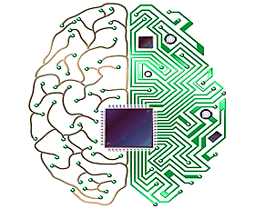
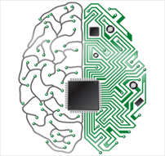
Cognitive Image Classification
EfficientNet: Rethinking Model Scaling for Convolutional Neural Networks
Sai Kumar Dandla
IBM certified DS Professional | Google Certified Tensor flow Developer
AI Researcher, DRDO Young Scientist Lab-Cognitive Technologies

Slide 2
Agenda
Introduction and Highlights
Model Scaling
Compound Scaling
EfficientNet Architecture
EfficientNet-B0 Baseline Network
EfficientNet-B1 to B7
Scaling Up MobileNets and ResNets
ImageNet Results for EfficientNet
Inference Latency Comparison
Transfer Learning Results for EfficientNets
Reference
1
Cognitive Image Classification

Slide 3
Introduction and Highlights
Scaling up ConvNets is widely used to achieve better accuracy.
ResNet can be scaled from ResNet-18 to ResNet-200 by using more layers.
GPipe achieved 84.3% ImageNet top-1 accuracy by scaling up a baseline model 4 times larger
The most common way is to scale up ConvNets by their depth, width, or image resolution.
In previous work, it is common to scale only one of the three dimensions.
Though it is possible to scale up two or three dimensions arbitrarily, arbitrary scaling requires tedious manual tuning and still often yields sub-optimal accuracy and efficiency.
The authors want to study and rethink the process of scaling up ConvNets
Empirical study shows that it is critical to balance all dimensions of network width/depth/resolution, and surprisingly such balance can be achieved by simply scaling each of them with constant ratio
Based on this observation, authors propose a compound scaling methods.
Cognitive Image Classification

Slide 4
Model Scaling
The idea of model scaling is to use a standard model like GoogleNet or ResNet and modify the architecture in one or more of the following ways
Change model depth: A CNN consists of several convolutional layers. These layers learn and encode different levels of abstraction of the input image. A CNN with a larger number of layers ( i.e. a deeper network ) can hold richer details about the image and therefore is usually more accurate than a model with a fewer number of layers ( i.e. a shallow network).
Change model width: A CNN layer also have multiple channels much like the R, G, and B channels of an image. A network with more channels per layer is considered wider than a network with fewer channels.
Input image resolution: CNN architectures take in images of fixed size as input. It is obvious that a 512×512 image has more information than a 256×256 image. Therefore, one can change the architecture to take in a larger input image and improve accuracy. This increase in accuracy but requires more processing power because a 512×512 image has 4x more pixels compared to a 256×256 image.
Cognitive Image Classification

Slide 5
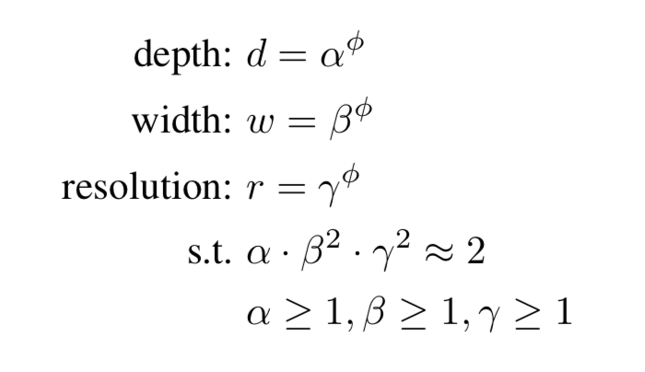
Compound Scaling
In the paper, the authors propose a compound scaling method that uses a compound coefficient of to uniformly scale width, depth, and resolution in a principled way
They propose the following formula
is a user-specified coefficient that controls resources (e.g. Floating Point Operations (FLOPs)) available for model scaling.
distribute the resources to depth, width, and resolution respectively.
Cognitive Image Classification

Slide 6


EfficientNet Architecture
Inspired by MNasNet, the authors develop our baseline network by leveraging a multi-objective neural architecture search that optimizes both accuracy and FLOPS.
Optimization Goal :
where
Latency is not included in the optimization goal since they are not targeting any specific hardware device.
Cognitive Image Classification

Slide 7
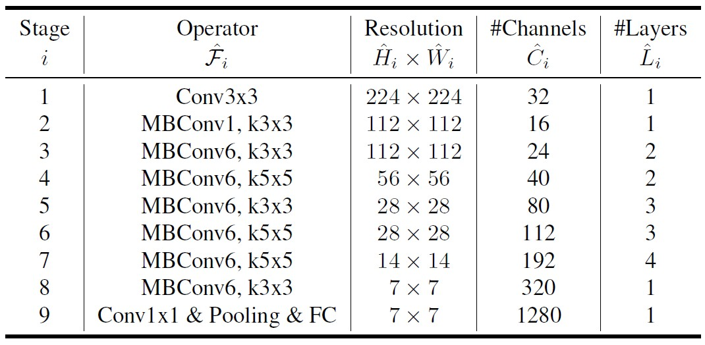
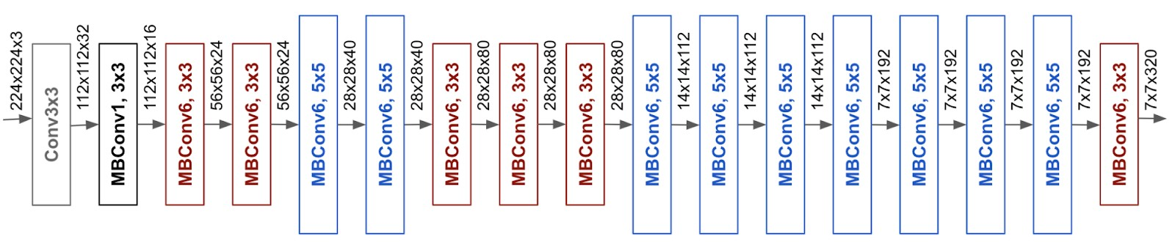
EfficientNet-B0 Baseline Network
Cognitive Image Classification

Slide 8
EfficientNet-B1 to B7
Step 1:
We first fix φ = 1, assuming twice more resources available and do a small grid search of α, β, γ.
The best values for EfficientNet-B0 are α=1.2, β=1.1, γ=1.15.
Step 2:
We then fix α, β, γ as constants and scale up baseline network with different φ to obtain EfficientNet-B1 to B7.
Cognitive Image Classification

Slide 9
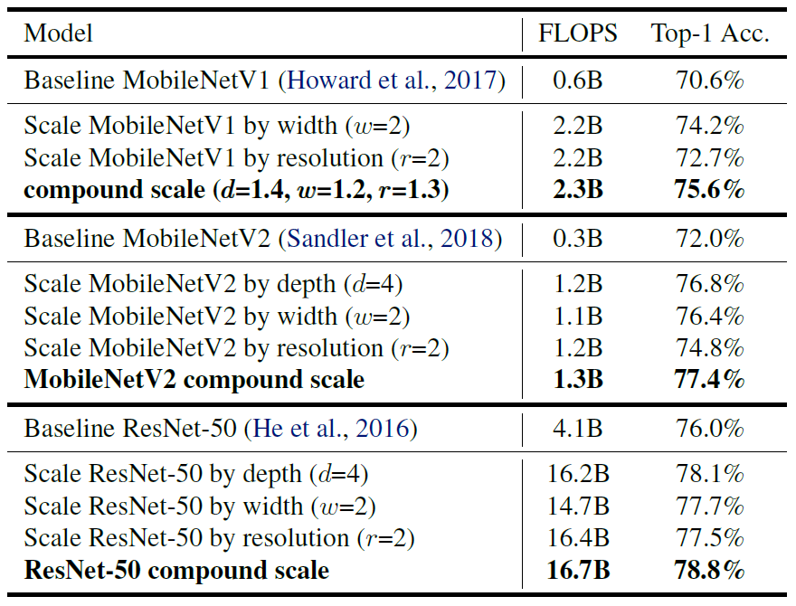
Scaling Up MobileNets and ResNets
Cognitive Image Classification

Slide 10
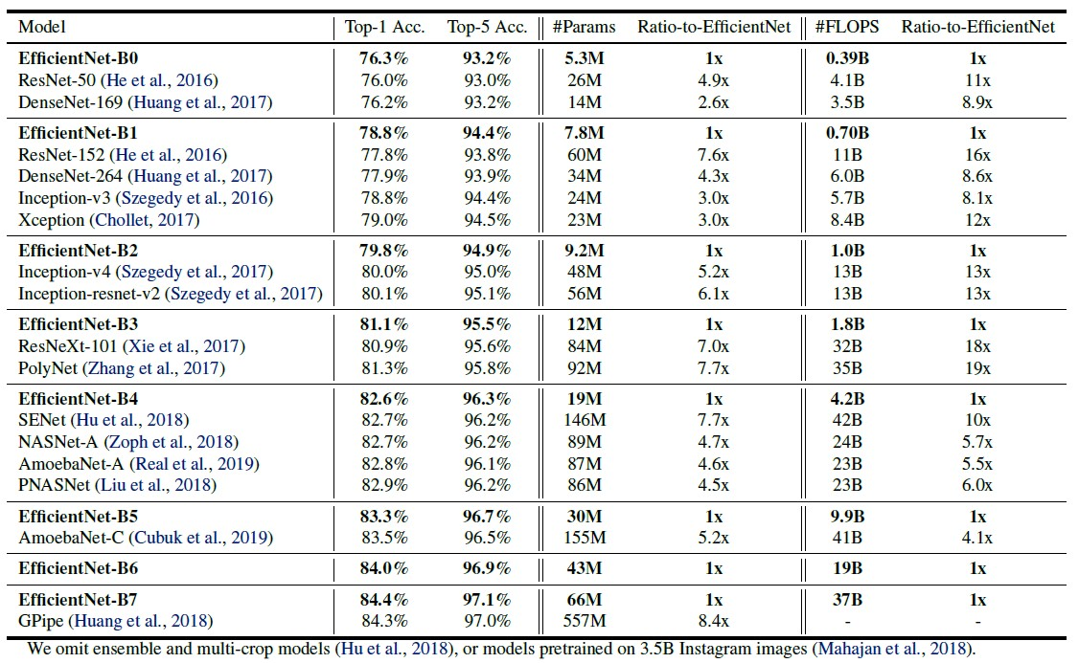
ImageNet Results for EfficientNet
Cognitive Image Classification

Slide 11
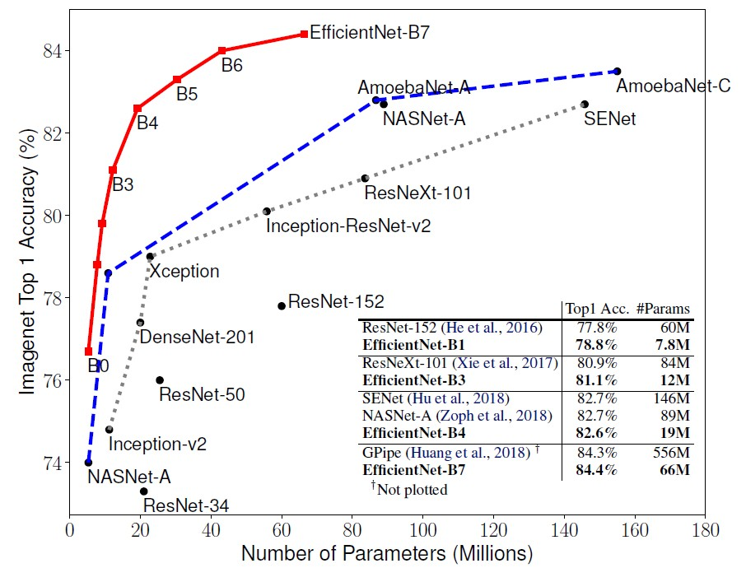
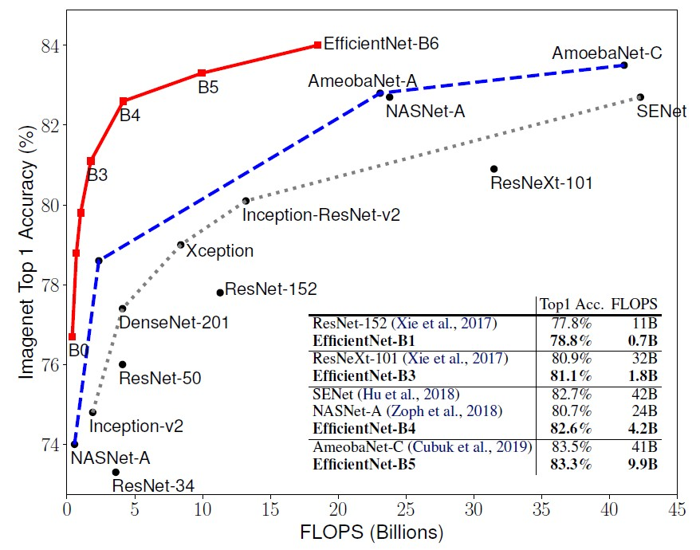
ImageNet Results for EfficientNet
Cognitive Image Classification

Slide 12
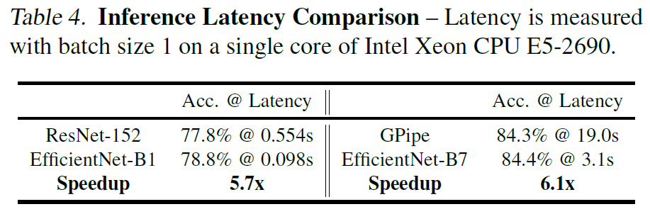
Inference Latency Comparison
Cognitive Image Classification

Slide 13
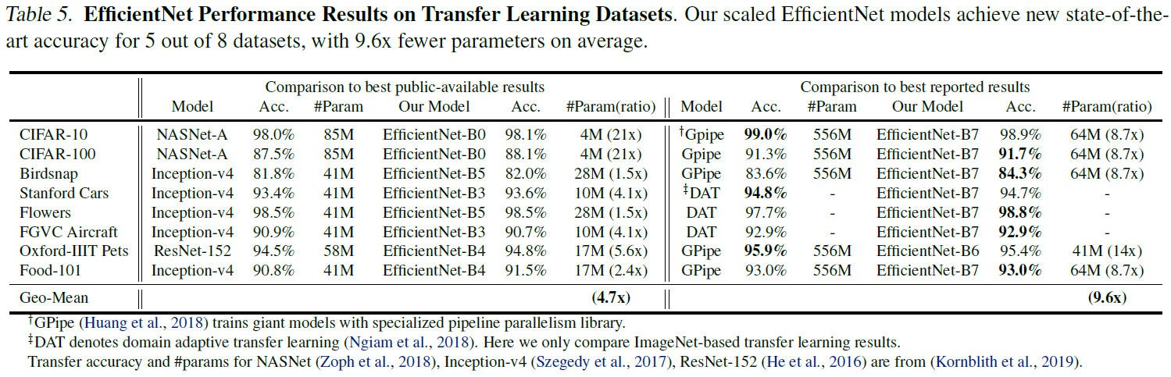
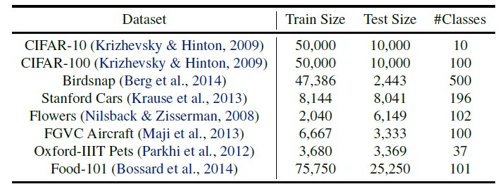
Transfer Learning Results for EfficientNets
Cognitive Image Classification

Slide 14
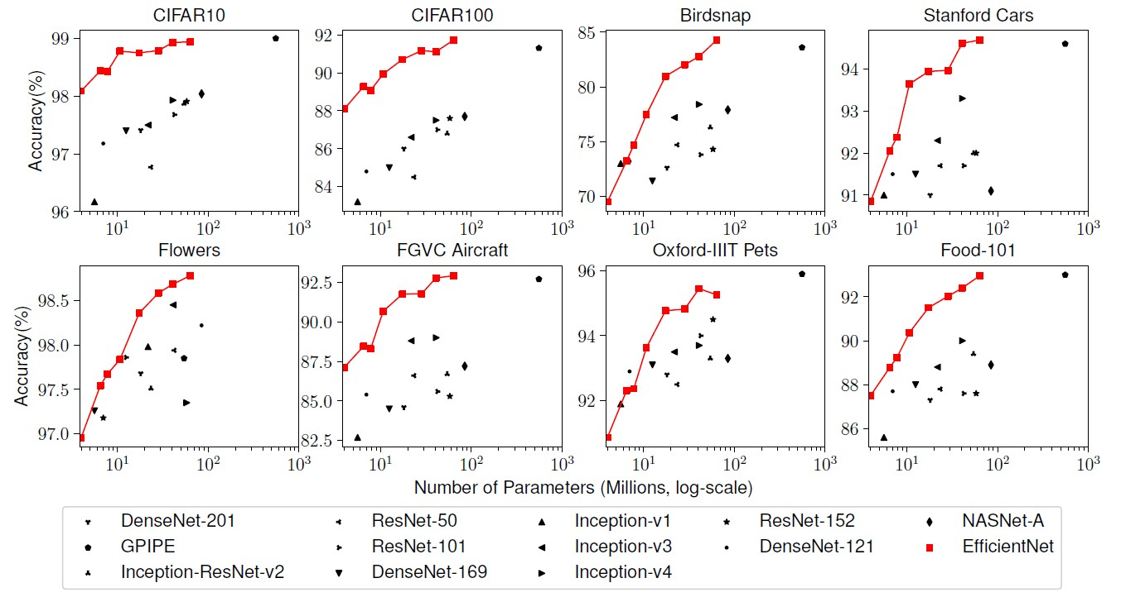
Transfer Learning Results for EfficientNets
Cognitive Image Classification

Slide 15
Reference
Google AI Blog
https://ai.googleblog.com/2019/05/efficientnet-improving-accuracy- and.html
Learn OpenCV Blog
Satya Mallick
Jinwon Lee
PR-169: EfficientNet: Rethinking Model Scaling for CNN (slideshare.net)
Paperswithcode
https://paperswithcode.com/task/image-classification
Cognitive Image Classification

